Slide 1
TRAVEL ENTREPRENEURSHIP AND SUSTAINABLE MARKETING Lecture 22
Topic:
Meaning, Concept, Definition and Types of Travel Entrepreneurship

Slide 2
Definition
tourism enterprise as “a composition of products involving transport, accommodation, catering, natural resources, entertainment and other facilities and services, such as shops and banks and other tour operators.”
A ‘tourism entrepreneur’ may be defined as a person or a group of persons producing and managing tourism products. In this process, the entrepreneur must have the commonly prescribed entrepreneurial traits along with service sector specialties.

Slide 3
Feature of entrepreneur
Willingness to accept responsibility.
Tend to moderate risk.
Creativity.
Anticipating the future.
Tolerance for ambiguity.
The high level of energy

Slide 4
Types of tourism entreprenuwership
Travel agents
Tour operators
Lodging and catering service providers.
Transport operators
Information and guiding
Attractions

Slide 5
Problems of tourism entreprenuership
Lack of proper infrastructure
Lack of conservation os cultural and religious sites
Lack of tourism centers
Lack of publicity
Lack of security
Political instability and unrest

Slide 6
Factors affecting tourism entrepreneurship
Participation of the private sector
Development of tourism infrastructure and facilities
Promotion of religious tourism
Focus on adventure tourism
Security
Encouragement to local investment
Transport and communication facility
Diversification
Promotion of environment

Slide 7
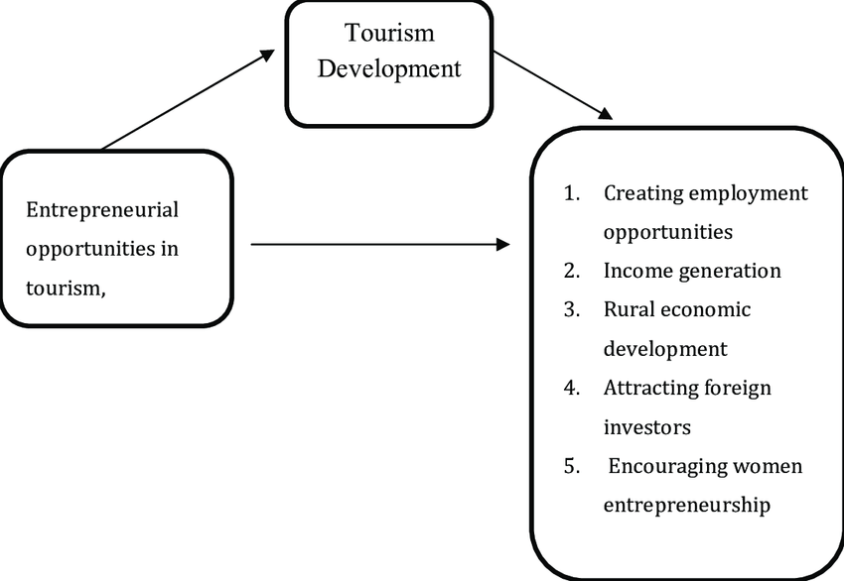

Slide 8
